Slide 1
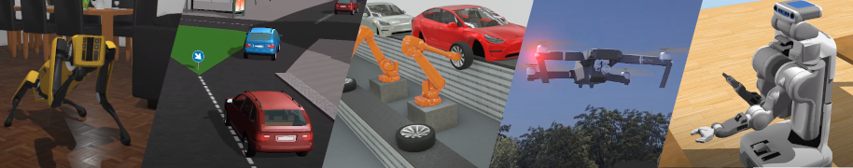
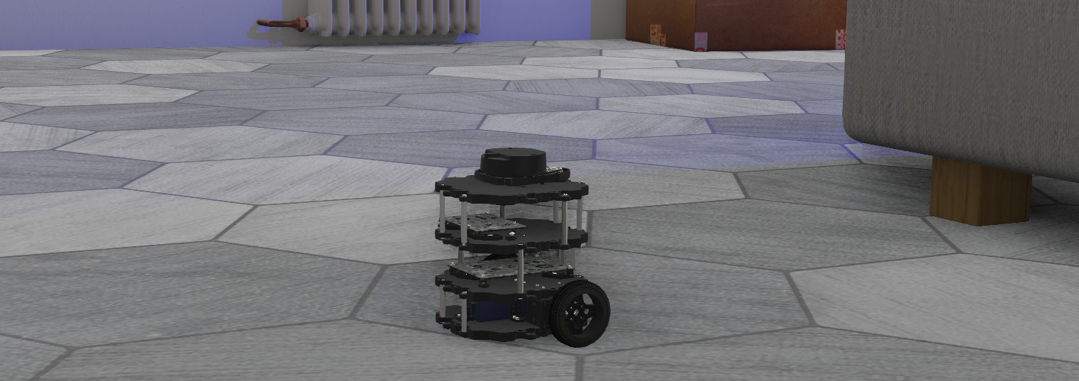
Robots in Simulation
Olly Smith

Slide 2
Overview
Lecture Part One
Theory – The value of simulation
What is a simulation?
Why is simulation important?
How can we use simulation in robotics?
Conclusion – The value of simulation
Lecture Part Two
“Practical” – Your robot in Webots
Webots guided tour
Tutorials
Preparing your robot in F360 for export
Exporting your robot to a URDF or PROTO file
Importing your model into Webots
Controlling your robot in Webots
Webots & ROS
Schedule
25.11.21
Lecture
Lab 1 / Revision
02.12.21
Lab 2 / Revision
09.12.21
Lab 3 / Revision

Slide 3
What is a Simulation?
A simulation is the imitation of the operation of a real-world process or system over time.^{[1]} Simulations require the use of models; the model represents the key characteristics or behaviors of the selected system or process, whereas the simulation represents the evolution of the model over time. Often, computers are used to execute the simulation.
Simulation is used in many contexts, such as simulation of technology for performance tuning or optimizing, safety engineering, testing, training, education,^{[2]} and video games. Simulation is also used with scientific modelling of natural systems^{[2]} or human systems to gain insight into their functioning,^{[3]} as in economics. Simulation can be used to show the eventual real effects of alternative conditions and courses of action. Simulation is also used when the real system cannot be engaged, because it may not be accessible, or it may be dangerous or unacceptable to engage, or it is being designed but not yet built, or it may simply not exist.^{[4]}
https://en.wikipedia.org/wiki/Simulation

Slide 4
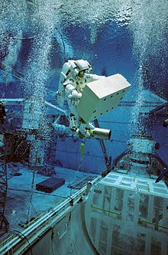
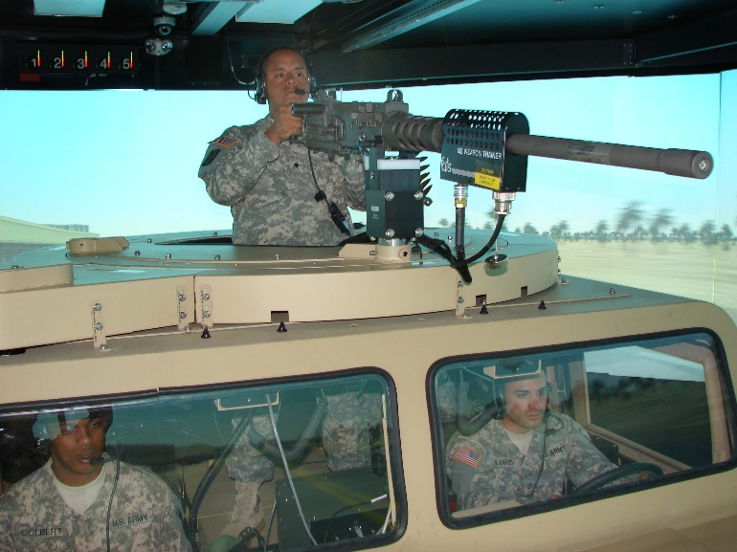
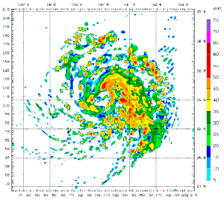
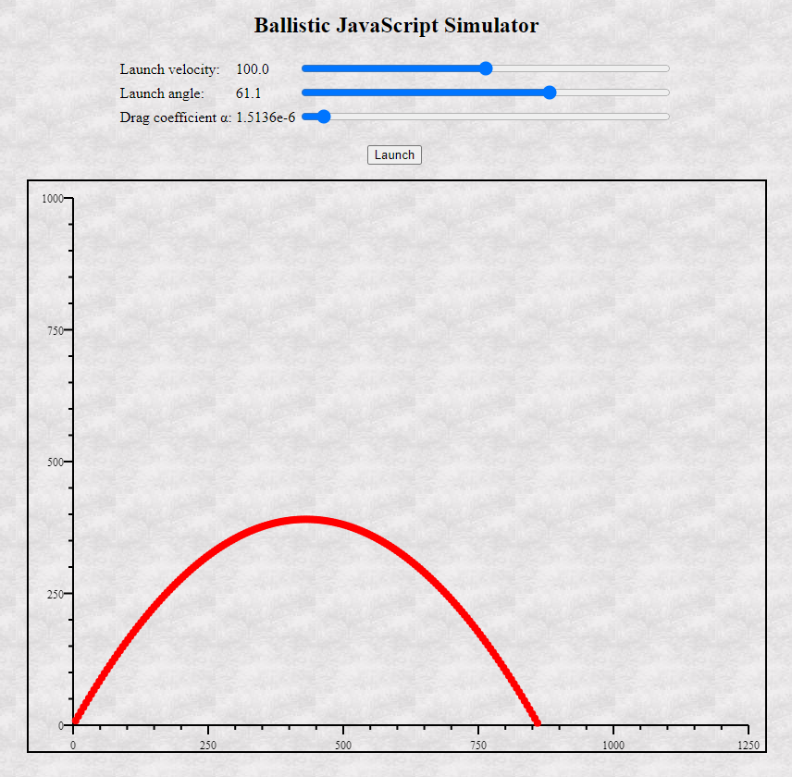
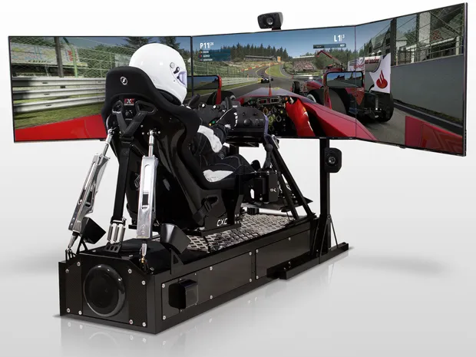
What is a Simulation? – In Example
A 48-hour computer simulation of Typhoon Mawar using the Weather Research and Forecasting model
Trajectory Calculation
http://www.physics.smu.edu/fattarus/ballistic.html

Slide 5
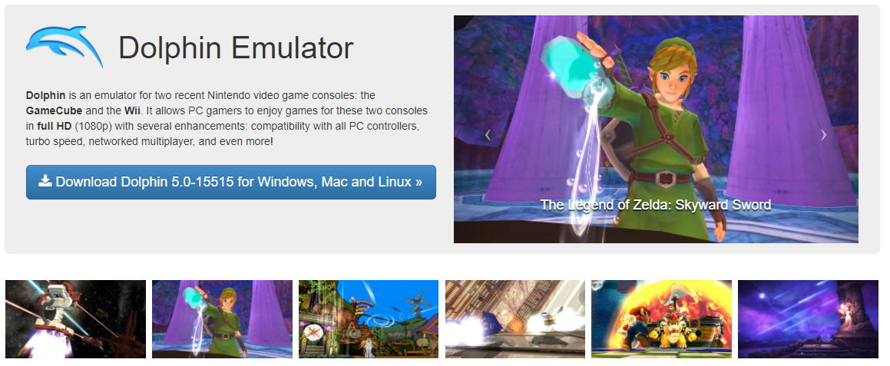
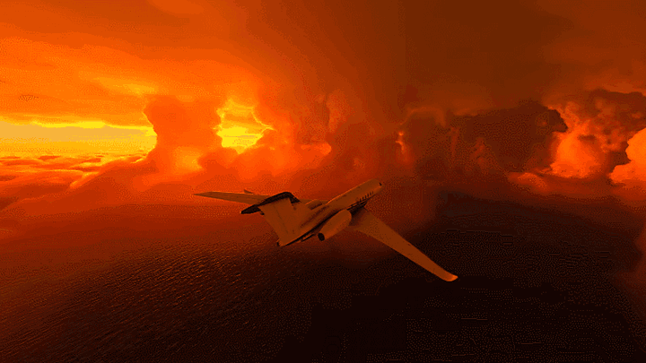
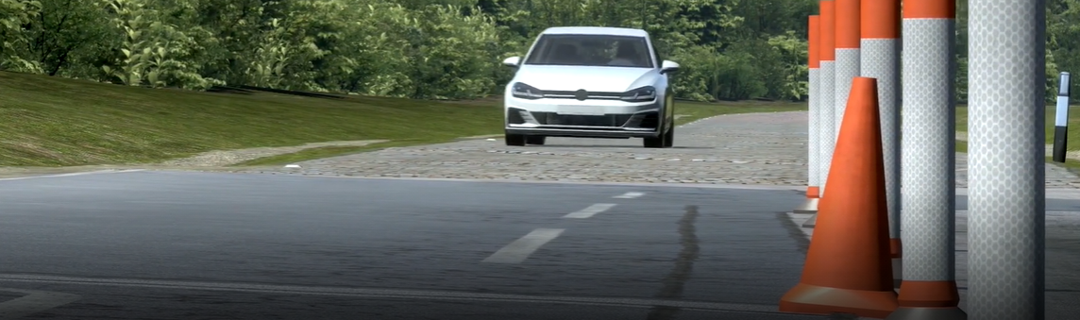
What is a Simulation? – In Example
MicroSoft FlightSim
Dolphin, a video game emulator, which simulates the behavior of the hardware, BIOS, and operating system of the GameCube/Wii console.
rFpro provides driving simulation software, and Digital-Twins, for the development and testing of autonomous vehicles, ADAS and vehicle dynamics.

Slide 6
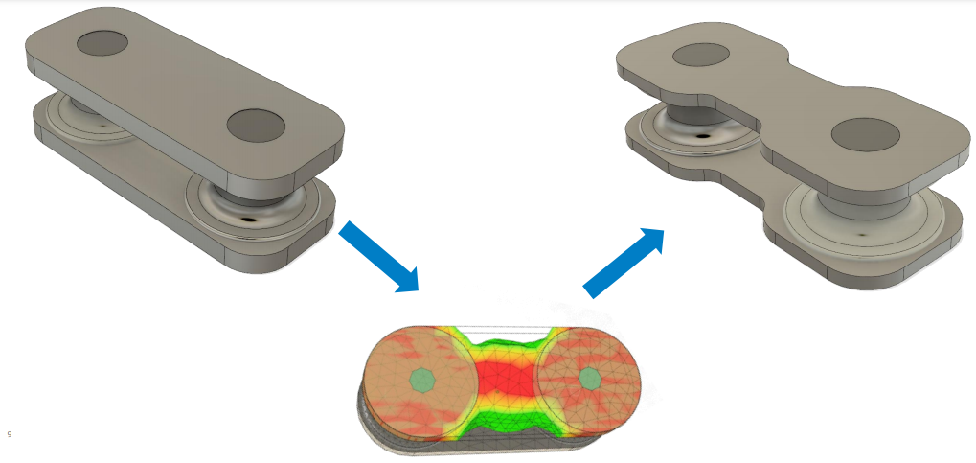
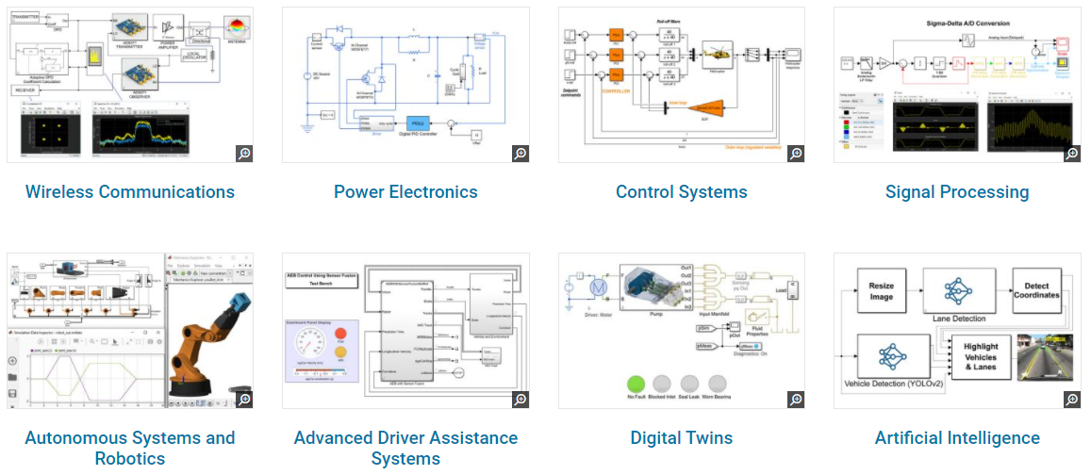
What is a Simulation? – In Example
MATLAB Simulink
Mass reduction using Finite Element Analysis, in Fusion 360

Slide 7
What is a Robotics Simulator?
A robotics simulator is a simulator used to create application for a physical robot without depending on the actual machine, thus saving cost and time. In some case, these applications can be transferred onto the physical robot (or rebuilt) without modifications.
One of the most popular applications for robotics simulators is for 3D modeling and rendering of a robot and its environment. This type of robotics software has a simulator that is a virtual robot, which is capable of emulating the motion of an actual robot in a real work envelope. Some robotics simulators use a physics engine for more realistic motion generation of the robot. The use of a robotics simulator for development of a robotics control program is highly recommended regardless of whether an actual robot is available or not. The simulator allows for robotics programs to be conveniently written and debugged off-line with the final version of the program tested on an actual robot.
This primarily holds for industrial robotic applications only, since the success of off-line programming depends on how similar the real environment of the robot is to the simulated environment. Sensor-based robot actions are much more difficult to simulate and/or to program off-line, since the robot motion depends on the instantaneous sensor readings in the real world.
https://en.wikipedia.org/wiki/Robotics_simulator

Slide 8
What is a Robotics Simulator?
A robotics simulator is a simulator used to create application for a physical robot without depending on the actual machine, thus saving cost and time. In some case, these applications can be transferred onto the physical robot (or rebuilt) without modifications.
One of the most popular applications for robotics simulators is for 3D modeling and rendering of a robot and its environment. This type of robotics software has a simulator that is a virtual robot, which is capable of emulating the motion of an actual robot in a real work envelope. Some robotics simulators use a physics engine for more realistic motion generation of the robot. The use of a robotics simulator for development of a robotics control program is highly recommended regardless of whether an actual robot is available or not. The simulator allows for robotics programs to be conveniently written and debugged off-line with the final version of the program tested on an actual robot.
This primarily holds for industrial robotic applications only, since the success of off-line programming depends on how similar the real environment of the robot is to the simulated environment. Sensor-based robot actions are much more difficult to simulate and/or to program off-line, since the robot motion depends on the instantaneous sensor readings in the real world.
https://en.wikipedia.org/wiki/Robotics_simulator

Slide 9
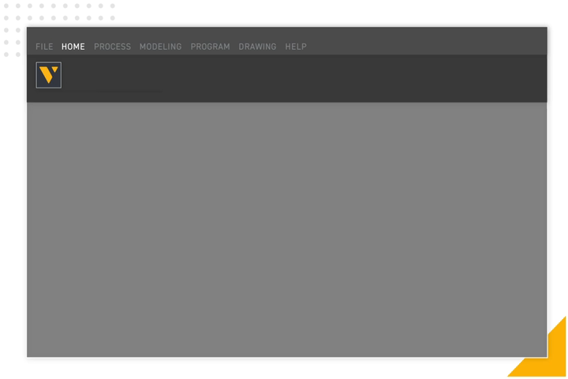
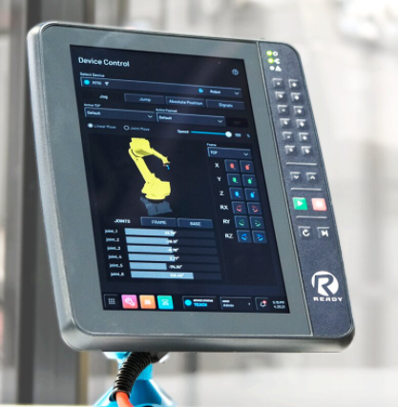
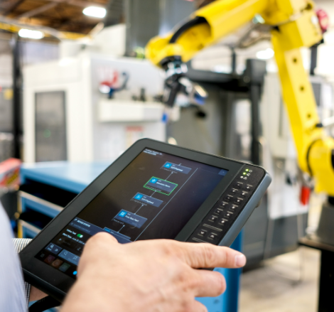
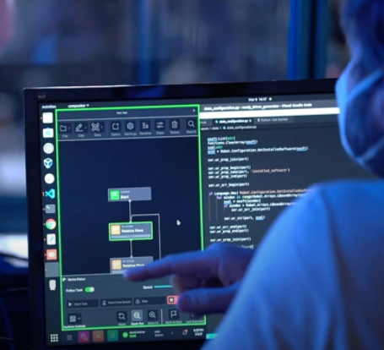
What is a Robotics Simulator? – Industrial Robotics Simulation
Visual Components
https://www.visualcomponents.com/
Siemens Tecnomatix
https://www.plm.automation.siemens.com/global/en/products/tecnomatix/
RoboLogix
https://www.robologix.com/
Forge OS
https://www.ready-robotics.com/software/forge-os
https://www.visualcomponents.com/resources/blog/robot-simulation-software-everything-you-need-to-know/
Top Seven Reasons to use Robotics Simulation in Industry:
To check if you’re investing in the right robots
To avoid costly mistakes
To avoid accidents
To complete projects faster
To save installation costs by checking the reach
To guard against collisions
To communicate how the cell will look and work

Slide 10
A brief pause Any questions?
Next up… What is a Robotics Simulator

Slide 11
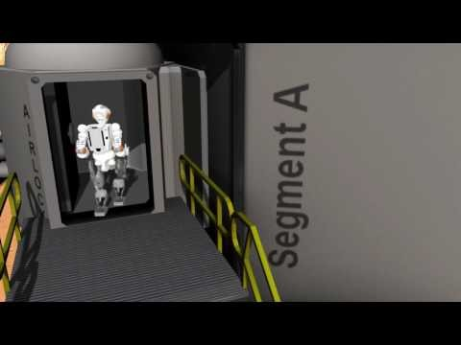
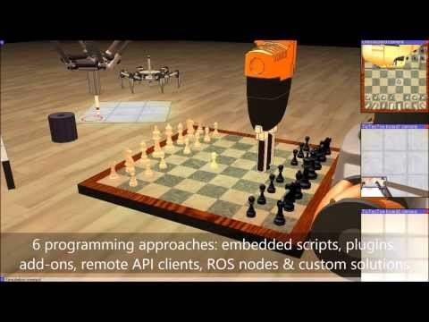

What is a Robotics Simulator? – “the big three”
Ignition / Ignition (formerly Gazebo)
Est. Open Robotics 2012, spin off company from Willow Garage
OpenSource under Apache 2.0
Ignition is the successor to Gazebo
Ignition uses DART physics engine by default. Gazebo uses ODE
Ignition custom visual rendering based on OGRE2.1
DARPA Robotics Challenge (2012-15)
NASA Space Robotics Challenge (2016-17)
Agile Robotics for industrial automation competition (2016-20)
DARPA Service Academy Swarm Challenge (2016-17)
DARPA Subterranean Challenge (2018-21)
CoppeliaSim (formerly VREP)
Est. CoppeliaSim 2012, Zurich, Switzerland
OpenSource under GPL for education & research
Supports multiple physics engines, Bullet, ODE, Vortex, Newton Game Dynamics
Custom visual rendering engine based on OpenGL
Popular in among academic research https://www.coppeliarobotics.com/citingPapers
Webots
Est. Cyberbotics 1998, spin off company from EPFL, Swiss University
OpenSource under Apache 2.0, as of 2019
Custom version of the Open Dynamics Engine (ODE) physics engine
Custom visual rendering engine WREN, based of OpenGL 3.3
Used in RoboCup Virtual Humanoid League
Can export a world to an interactive html page! https://cyberbotics.com/doc/guide/atlas

Slide 12
What is a Robotics Simulator? – Overview
What is a Robotics Simulator?
Architecture
Simulation “Master”
Communication Library
Physics Library
Rendering Library
Sensor Generation
GUI
Plugins
How can we use Simulation in Robotics?
Main Features
Multiple Programming Approaches
Powerful APIs
Remote API
Dynamics / Physics
Inverse / Forward Kinematics
Dynamic Particles
Collision Detection
Minimum Distance Calculation
Cross- Platform & Portable
Proximity & Vision Sensor Simulation
Building Block Concept
Path / Motion Planning
Data Recording & Visualization
Custom User Interfaces
Integrated Model Editing
Import / Export Data
Scene Hierarchy, Model Browser, Interaction
Why is it important?
Applications
Visualize robots and their environments
3D Visual Rendering, Physics Engine, GUI, Script Editor & Scene Tree
Develop your robots without access to expensive hardware
Break robots at zero cost
Learn how to use advanced robots and their sensors
Sensors: IMU, LIDAR, RGBD, Cameras
Robots: Spot, Atlas, E-Puck, TurtleBot
Machine learning (aka the future)
Generate dataset in simulation (Augmentation)
Train / Test robots in simulation
Hardware acceleration (GPU), time acceleration
Communicate your work to the public with ease
Employers, Investors, Friends & Family, Social Media

Slide 13
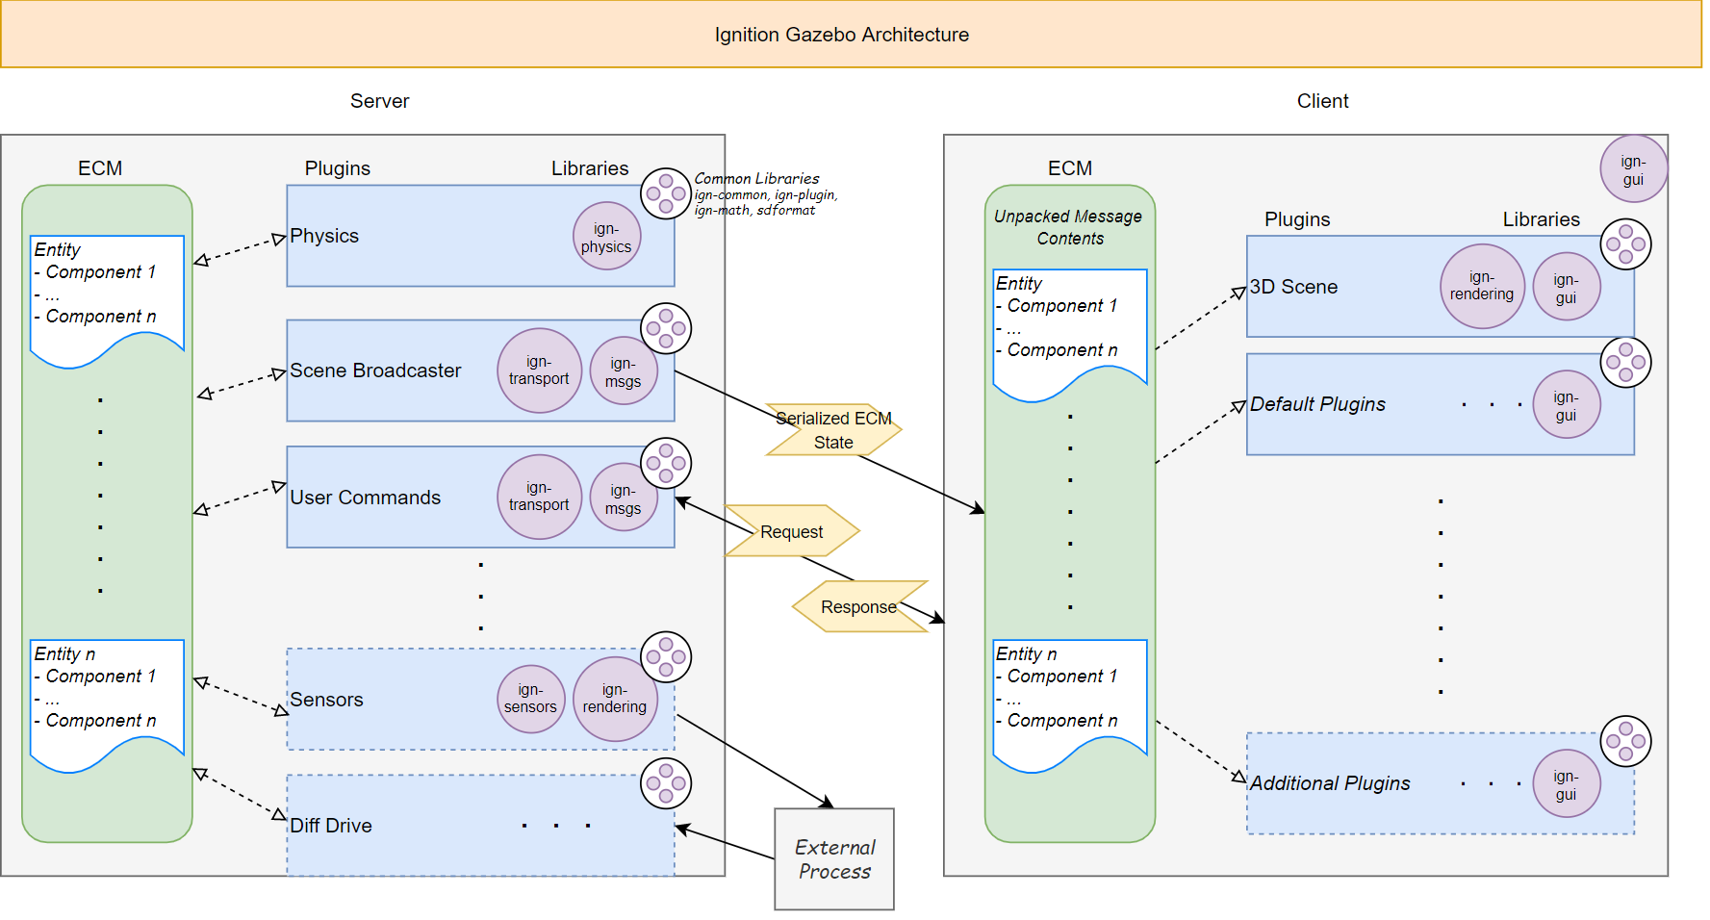
What is a Robotics Simulator? – Architecture
https://ignitionrobotics.org/docs/all/architecture

Slide 14
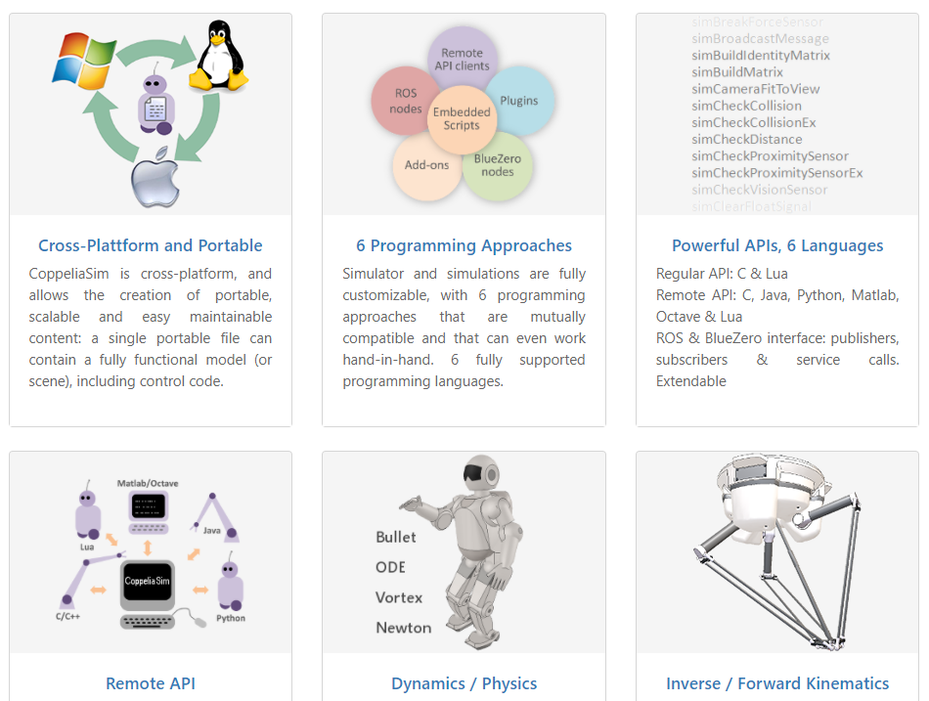
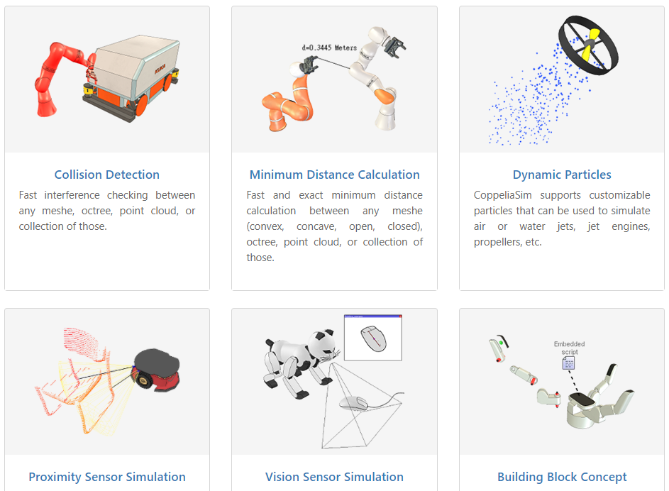
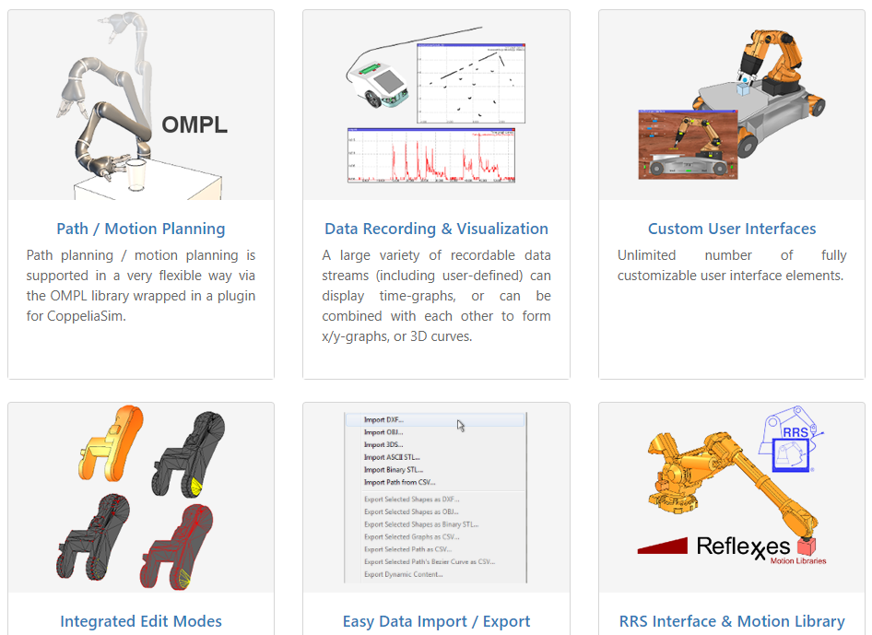
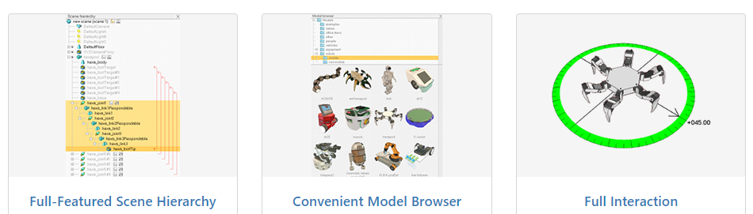
How can we use simulation in robotics?
https://www.coppeliarobotics.com/features

Slide 15
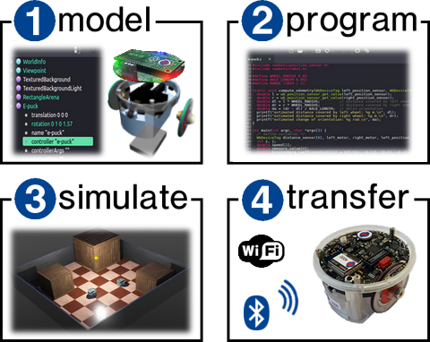
Why is simulation important?
Why is it important?
Applications
Visualize robots and their environments
3D Visual Rendering, Physics Engine, GUI, Script Editor & Scene Tree
Develop your robots without access to expensive hardware
Break robots at zero cost
Learn how to use advanced robots and their sensors
Sensors: IMU, LIDAR, RGBD, Cameras
Robots: Spot, Atlas, E-Puck, TurtleBot
Machine learning (aka the future)
Generate training data in simulation
Train / Test robots in simulation
Hardware acceleration (GPU), time acceleration
Communicate your work to the public with ease
Employers, Investors, Friends & Family, Social Media
https://cyberbotics.com/doc/guide/index

Slide 16
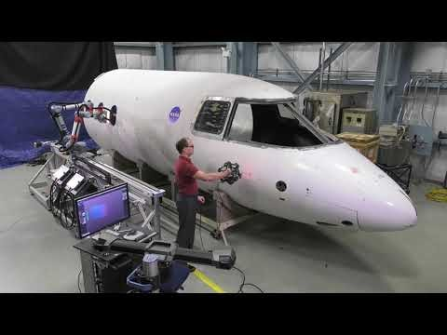
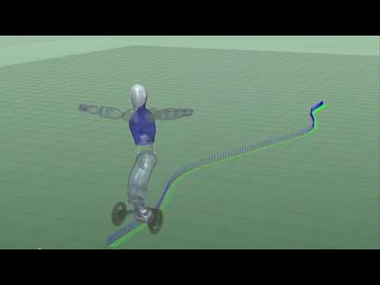
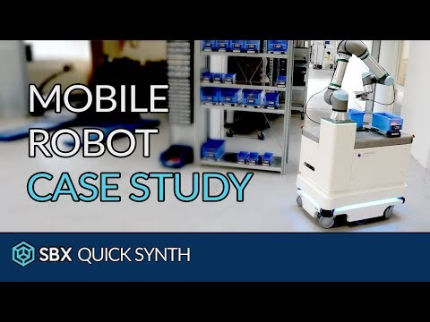
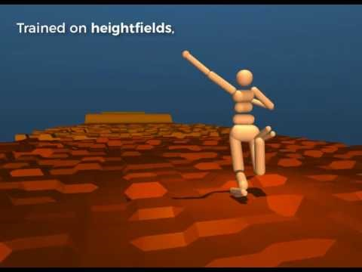
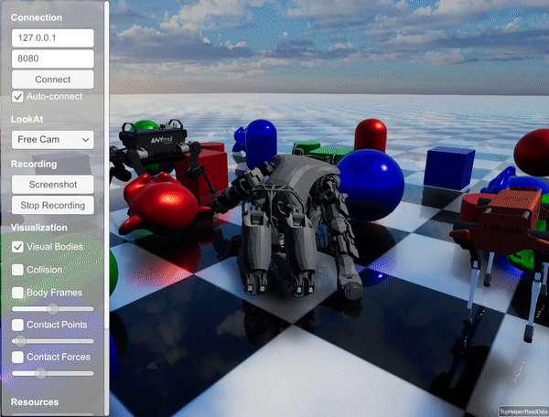
What is a Robotics Simulator? – other simulators
RoboDK https://robodk.com/
Drake https://drake.mit.edu/
Video Game engines in robotics
(Unity & Unreal)
Unity Engine
Craighead, J., Burke, J. and Murphy, R., 2008, September. Using the unity game engine to develop sarge: a case study. In Proceedings of the 2008 Simulation Workshop at the International Conference on Intelligent Robots and Systems (IROS 2008).
M. Santos Pessoa de Melo, J. Gomes da Silva Neto, P. Jorge Lima da Silva, J. M. X. Natario Teixeira and V. Teichrieb, "Analysis and Comparison of Robotics 3D Simulators," 2019 21st Symposium on Virtual and Augmented Reality (SVR), 2019, pp. 242-251, doi: 10.1109/SVR.2019.00049.
Blog “Robots are hard, game engines are not: why we built our own simulator using Unity“ https://formant.io/news-and-blog/2019/10/09/analytics/robots-are-hard-game-engines-are-not-why-we-built-our-own-simulator-using-unity/
Unreal Engine
USARSim: A Robotics Simulator based on the Unreal Enginer
S. Carpin, M. Lewis, J. Wang, S. Balakirsky and C. Scrapper, "USARSim: a robot simulator for research and education," Proceedings 2007 IEEE International Conference on Robotics and Automation, 2007, pp. 1400-1405, doi: 10.1109/ROBOT.2007.363180.
Blog “Using Unreal For Robotic Simulation” http://www.mitchellspryn.com/2019/12/30/Using-Unreal-For-Robotic-Simulation.html
Industrial Robot Arms only, closed source, educational license is $145 per user. Over 500 robots available, software intended for Small Medium Enterprises.
Open Source, in house engine by MIT, now supported by the Toyota Research Institute.
Mujoco https://mujoco.org/
RAIsim https://raisim.com/
SBX robotics, using the Unreal Engine to generate synthetic data for robotics AI
Legacy Simulators
OpenRave http://openrave.org/
SimSpark http://simspark.sourceforge.net/
USARsim https://sourceforge.net/projects/usarsim/
Search and Rescue Game Engine (SARGE) http://sarge.sourceforge.net/page11/page11.html
Recently bought by Deepmind (google) to go OpenSource in 2022. Best contact forces, pioneered Reinforcement Learning in Simulation.
Closed Source, in house engine by ETH Zurich, makers of the ANYmal Quadruped. Uses Raytracing.

Slide 17
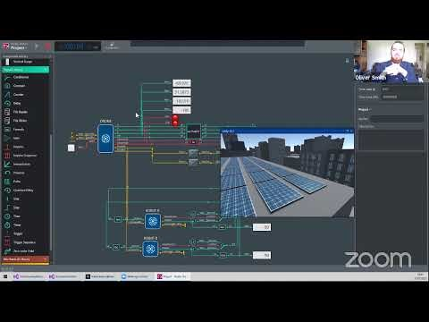
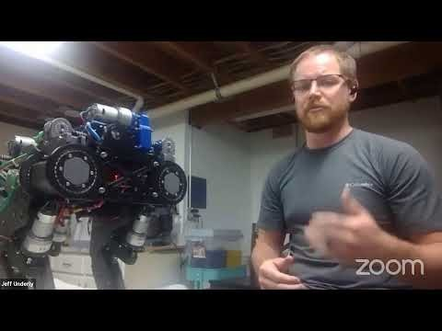
Research Papers
2011
Survey of Robotics Simulators
A. Harris and J. M. Conrad, "Survey of popular robotics simulators, frameworks, and toolkits," 2011 Proceedings of IEEE Southeastcon, 2011, pp. 243-249, doi: 10.1109/SECON.2011.5752942.
Comparing Robotics Simulators
K. Kumar and P. S. Reel, "Analysis of contemporary robotics simulators," 2011 International Conference on Emerging Trends in Electrical and Computer Technology, 2011, pp. 661-665, doi: 10.1109/ICETECT.2011.5760200.
2018
RaiSim paper
J. Hwangbo, J. Lee and M. Hutter, "Per-Contact Iteration Method for Solving Contact Dynamics," in IEEE Robotics and Automation Letters, vol. 3, no. 2, pp. 895-902, April 2018, doi: 10.1109/LRA.2018.2792536.
2019
Comparing Robotics Simulators
M. Santos Pessoa de Melo, J. Gomes da Silva Neto, P. Jorge Lima da Silva, J. M. X. Natario Teixeira and V. Teichrieb, "Analysis and Comparison of Robotics 3D Simulators," 2019 21st Symposium on Virtual and Augmented Reality (SVR), 2019, pp. 242-251, doi: 10.1109/SVR.2019.00049.
2020
Challenges of using Robotics Simulators
Afzal, A., Katz, D.S., Goues, C.L. and Timperley, C.S., 2020. A study on the challenges of using robotics simulators for testing. arXiv preprint arXiv:2004.07368.
Comparing simulators for Humanoid Robots
Ayala, A., Cruz, F., Campos, D., Rubio, R., Fernandes, B. and Dazeley, R., 2020, October. A Comparison of Humanoid Robot Simulators: A Quantitative Approach. In 2020 Joint IEEE 10th International Conference on Development and Learning and Epigenetic Robotics (ICDL-EpiRob) (pp. 1-6). IEEE.
Robotics simulators for Reinforcement Learning
D. Ferigo, S. Traversaro, G. Metta and D. Pucci, "Gym-Ignition: Reproducible Robotic Simulations for Reinforcement Learning," 2020 IEEE/SICE International Symposium on System Integration (SII), 2020, pp. 885-890, doi: 10.1109/SII46433.2020.9025951.
2021
The use of simulation in robotics (now and in future)
On the use of simulation in robotics: Opportunities, challenges, and suggestions for moving forward HeeSun Choi, Cindy Crump, Christian Duriez, Asher Elmquist, Gregory Hager, David Han, Frank Hearl, Jessica Hodgins, Abhinandan Jain, Frederick Leve, Chen Li, Franziska Meier, Dan Negrut, Ludovic Righetti, Alberto Rodriguez, Jie Tan, Jeff Trinkle Proceedings of the National Academy of Sciences Jan 2021, 118 (1) e1907856118; DOI: 10.1073/pnas.1907856118
Robotics simulators for Reinforcement Learning
T. Kim, M. Jang and J. Kim, "A Survey on Simulation Environments for Reinforcement Learning," 2021 18th International Conference on Ubiquitous Robots (UR), 2021, pp. 63-67, doi: 10.1109/UR52253.2021.9494694.
Validating Robotics Simulators on Real World Impacts
Acosta, B., Yang, W. and Posa, M., 2021. Validating Robotics Simulators on Real World Impacts. arXiv preprint arXiv:2110.00541.
2021 Reddit Robotics Showcase: Simulation
2021 Reddit Robotics Showcase: Legged Robots

Slide 18
15 minute break
Next up… “Practical” – Your robot in Webots
https://cyberbotics.com/
download & install

Slide 19
“Practical” – Your robot in Webots
Webots guided tour
Tutorials
Preparing your robot in F360 for export
Exporting your robot to a URDF or PROTO file
Importing your model into Webots
Controlling your robot in Webots
Webots & ROS
Image of simple quadruped in webots

Slide 20
Webots guided tour
On first run the Guided tour should pop up, if not
File>help?Webots guided tour

Slide 21
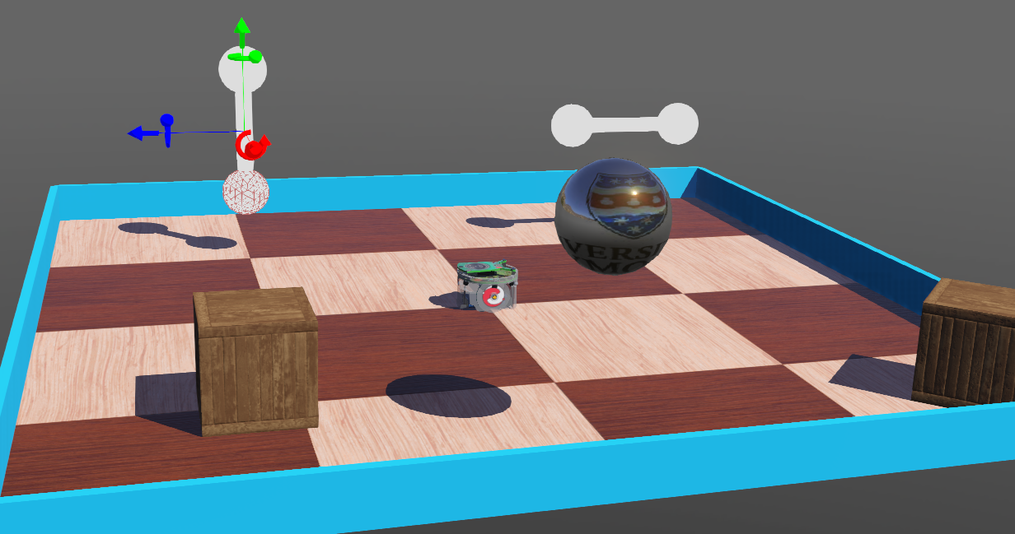
Tutorials
Bare Essentials
https://cyberbotics.com/doc/guide/tutorials
Tutorial 1: Your First Simulation in Webots (30 Minutes)
Tutorial 2: Modification of the Environment (30 Minutes)
Tutorial 4: More about Controllers (30 Minutes)
Tutorial 6: 4-Wheeled Robot (60 Minutes)
Tutorial 7: Your First PROTO (20 Minutes)
(Optional reading)
Getting Started in Webots
https://cyberbotics.com/doc/guide/getting-started-with-webots
Results of Webots tutorials 1 - 5

Slide 22
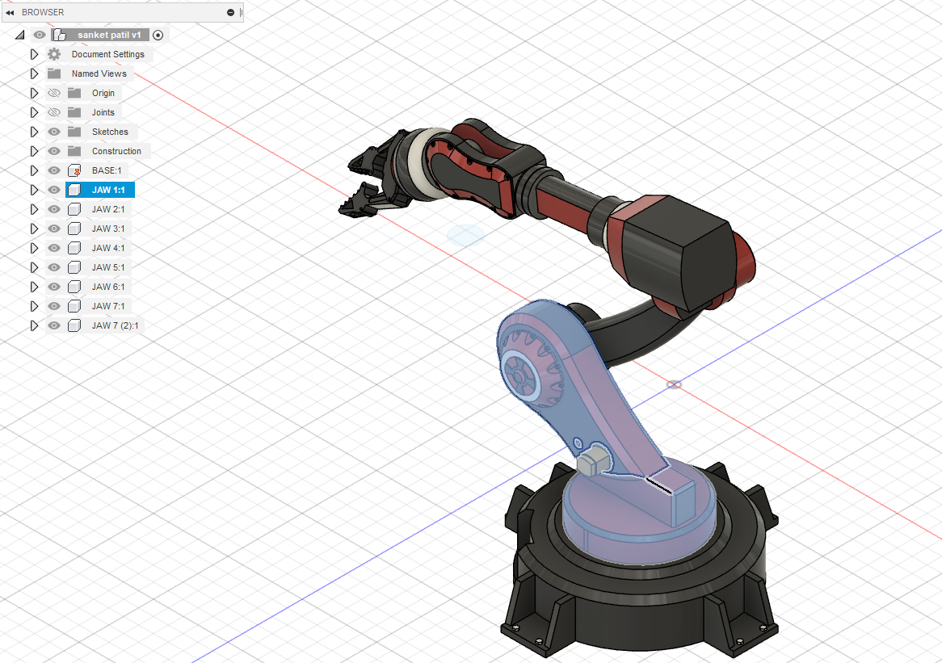
Preparing your robot in F360 for export
Combine Bodies ??? ??? ?? Check URDF scripts, read online tools from alex
Ask alex or jake for help if you need buddy ☺
https://github.com/SpaceMaster85/fusion2urdf

Slide 23
Exporting your robot to a URDF or PROTO file
https://github.com/Daemongear/RobotSimulator
download and install this script for Fusion 360: https://github.com/SpaceMaster85/fusion2urdf
use the script; pop the files into your WeBots world folder
use the urdf to proto script: https://github.com/cyberbotics/urdf2webots
then simply start WeBots and import the proto file.

Slide 24
Controlling your robot in Webots
Add text box with quadruped controller c++

Slide 25
Webots & ROS
Tutorial 9: Using ROS (60 Minutes)
GLHF
Notes on setting up the Scott Humanoid Robot…
NB: if you want ROS connections, also make a copy of those files into your workspace /src and convert the xacro to a urdf file. NB2: To use ROS with WeBots, have the robot controller set to "ros" or create your own custom controller. if you chose the standard "ros" controller, look into the provided documentation to find how the services and commands are called. That is also available online as part of the WeBots documentations and tutorials on ROS.
---- added by Olly in prep for ROC318 / RoboSoc Virtual Humanoids ----
New RoboSoc student simulator setup instructions
Laptop Setup
1.1 Install Ubuntu 18.04 "Bionic Beaver" Suggest using a spare USB stick to stick Ubuntu onto an old laptop https://ubuntu.com/tutorials/create-a-usb-stick-on-windows
1.2 Install terminator Open a terminal, and run the command "sudo apt-get install terminator". Use ctrl+shift+c & ctrl+shift+v when in a terminal to copy/paste. Open terminator, right click the icon, add to favourites. Terminator, is a greatly improved version of the bog-standard terminal. All the cool kids use it.
1.3 Install ROS-Melodic http://wiki.ros.org/melodic/Installation/Ubuntu
If you are not familiar with ROS, follow the beginner tutorials 1 - 13 http://wiki.ros.org/ROS/Tutorials#Beginner_Level
Webots setup
2.1 Install Webots https://cyberbotics.com/doc/guide/installation-procedure#installation-on-linux
Click through a few of the demo applications to see how cool it is.
2.2 Install the Webots ROS package http://wiki.ros.org/webots_ros
Scott simulator setup 3.1 Copy/paste the world folder "scott_world" to the desktop 3.2 Create a folder on the desktop named "scott_sim_ws". This will be the ROS workspace for your project. 3.3 Inside the "scott_sim_ws" folder, create another folder "src". 3.4 Inside the "src" folder, copy/paste the ros package "scott_robot". 3.5 Find the file "testWorld.launch" scott_world>launch>testWorld.launch and edit the line doc="path to the world", replace the quotes inside with the ABSOLUTE address of the webots world where you have imported the robot.
Open a terminal (terminator) navigate to the workspace. "cd" to change directory, "ls" to list files/folders within the current directory, "cd .." to go back. Run the command "catkin_make". This will build the workspace so that ROS recognises it.
LAUNCHING:
Open terminal step 1: cd Desktop/scott_sim_ws source devel/setup.bash roscore
new terminal tab (right click) source devel/setup.bash export webots home >>export WEBOTS_HOME=/usr/local/webots
run the simulation: roslaunch <the launch file - webots.launch>
Learning Resources
https://cyberbotics.com/doc/guide/tutorials
https://cyberbotics.com/doc/guide/tutorial-9-using-ros?tab-language=c++
http://wiki.ros.org/ROS/Tutorials
http://wiki.ros.org/urdf/Tutorials/Building%20a%20Movable%20Robot%20Model%20with%20URDF

Slide 26
Webots & ROS
Olly’s ideas of 2022 Roco318 ROS & Webots labs, ignoring the time required to design and build a Quadruped!
Lab One
Webots Tutorial 1: Your First Simulation in Webots (30 Minutes)
Webots Tutorial 2: Modification of the Environment (30 Minutes)
Homework
Webots Tutorial 3: Appearance (20 Minutes)
Webots Tutorial 4: More about Controllers (30 Minutes)
Webots Tutorial 5: Compound Solid and Physics Attributes (15 Minutes)
Lab Two
Webots Tutorial 6: 4-Wheeled Robot (60 Minutes)
Homework
Webots Tutorial 7: Your First PROTO (20 Minutes)
Webots Tutorial 8: the Supervisor (30 Minutes)
Lab Three
From Fusion 360 to Webots, using a simple Quadruped model
Coursework Part One
Quadruped Controller for a simple quadruped model in simulation
Lab Four
ROS Beginner Tutorials 1.1 (Installing & Configuring) – 1.4 (building a ROS package)
Homework
Complete Tutorials
Lab Five
ROS Beginner Tutorials 1.5 (Understanding ROS Nodes) , 1.6 (Understanding ROS Topics). 1.7 (Using rqt_console & roslaunch)
Homework
Complete Tutorials
Lab Five
ROS Beginner Tutorials 1.11 (Writing a simple Publisher & Subscriber in C++) & 1.13 (Examining the simple Publisher & Subscriber)
Homework
Write a Publisher & Subscriber for your embedded device (Arduino, Nucleo) or single board computer (Raspberry Pi, Odroid, Jetson) to blink an LED from your computer
Lab Six
Working with ROS. Using other packages, rqt_graph, URDF, Rviz. Demonstration with a Lidar and IMU.
Homework
ROS urdf/tutorials/Building a Moveable Robot with URDF, using the premade R2D2 model. http://wiki.ros.org/urdf/Tutorials/Building%20a%20Movable%20Robot%20Model%20with%20URDF
Lab Seven
Webots Tutorial 9: Using ROS (60 Minutes)
Coursework
Control your physical robot via Webots
Learning Resources
https://cyberbotics.com/doc/guide/tutorials
http://wiki.ros.org/ROS/Tutorials
http://wiki.ros.org/urdf/Tutorials/Building%20a%20Movable%20Robot%20Model%20with%20URDF
Tutorial 9: Using ROS (60 Minutes)
GLHF
Notes on setting up the Scott Humanoid Robot…
NB: if you want ROS connections, also make a copy of those files into your workspace /src and convert the xacro to a urdf file. NB2: To use ROS with WeBots, have the robot controller set to "ros" or create your own custom controller. if you chose the standard "ros" controller, look into the provided documentation to find how the services and commands are called. That is also available online as part of the WeBots documentations and tutorials on ROS.
---- added by Olly in prep for ROC318 / RoboSoc Virtual Humanoids ----
New RoboSoc student simulator setup instructions
Laptop Setup
1.1 Install Ubuntu 18.04 "Bionic Beaver" Suggest using a spare USB stick to stick Ubuntu onto an old laptop https://ubuntu.com/tutorials/create-a-usb-stick-on-windows
1.2 Install terminator Open a terminal, and run the command "sudo apt-get install terminator". Use ctrl+shift+c & ctrl+shift+v when in a terminal to copy/paste. Open terminator, right click the icon, add to favourites. Terminator, is a greatly improved version of the bog-standard terminal. All the cool kids use it.
1.3 Install ROS-Melodic http://wiki.ros.org/melodic/Installation/Ubuntu
If you are not familiar with ROS, follow the beginner tutorials 1 - 13 http://wiki.ros.org/ROS/Tutorials#Beginner_Level
Webots setup
2.1 Install Webots https://cyberbotics.com/doc/guide/installation-procedure#installation-on-linux
Click through a few of the demo applications to see how cool it is.
2.2 Install the Webots ROS package http://wiki.ros.org/webots_ros
Scott simulator setup 3.1 Copy/paste the world folder "scott_world" to the desktop 3.2 Create a folder on the desktop named "scott_sim_ws". This will be the ROS workspace for your project. 3.3 Inside the "scott_sim_ws" folder, create another folder "src". 3.4 Inside the "src" folder, copy/paste the ros package "scott_robot". 3.5 Find the file "testWorld.launch" scott_world>launch>testWorld.launch and edit the line doc="path to the world", replace the quotes inside with the ABSOLUTE address of the webots world where you have imported the robot.
Open a terminal (terminator) navigate to the workspace. "cd" to change directory, "ls" to list files/folders within the current directory, "cd .." to go back. Run the command "catkin_make". This will build the workspace so that ROS recognises it.
LAUNCHING:
Open terminal step 1: cd Desktop/scott_sim_ws source devel/setup.bash roscore
new terminal tab (right click) source devel/setup.bash export webots home >>export WEBOTS_HOME=/usr/local/webots
run the simulation: roslaunch <the launch file - webots.launch>

